Slide 1
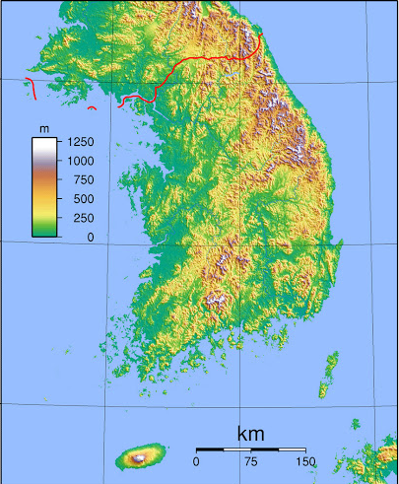
The Korean Wine Market
Embassy of Greece in Seoul, Economic & Commercial Office
April 2021

Slide 2
In the not so distant past, South Korea was a VERY poor country.

Slide 3
It’s also a unique case of a country which passed from third world to first world status at the end of the 20th century.
Korea has become the 9th biggest economy worldwide with a total GDP of more than 1.6 trillion USD, overcoming Australia, Canada, Russia and Brazil.
Korean money is new money, it wants to be spent and show itself. Korean consumers love status symbol brands and are big spenders.

Slide 4
What kind of country is South Korea?
South Korea is 24% smaller than Greece.
It has 52 million people, 5 times the population of Greece.
Population density is 6,5 times higher, same as Greece had a 70 million population.
The population is extremely homogenous, 95% Korean.
Extremely high urbanization rate : 81.5% of the population live in cities.
Topography similar to Greece : very mountainous interior, people mainly live in costal areas, predominantly in the West and South of the country.

Slide 5
Import Requirements
The EU-Korea FTA removed import customs duties for wine.
For merchandise value in excess of 6.000 € the winery needs to acquire an “Authorization of Approved Exporter” and an “Approved Exporter Number” from the Member State’s Customs Authorities.
The invoice has to include an Origin Declaration by the approved exporter.
EU organic product certifications are accepted in the RoK.
Labelling has to be exact and accurate, accompanied by the equivalent documentation.
All imported wines need to have additional stickers in Korean.

Slide 6
The Korean Wine Market
Still a young market, wine less popular than beer and native strong alcoholic beverage soju.
No national production. All wine fully imported.
In Korea, alcohol consumption is not permitted under 19 years old. Also forbidden are internet sales and TV promotion between 7AM and 10 PM.
Main suppliers from the EU are France, Italy, Spain, Portugal, and Germany. Out of the EU, Chile, USA, Australia, Argentina, and New Zealand.

Slide 7
Imports have increased gradually but steadily.

Slide 8
In COVID year 2020, strict social distancing measures triggered increased alcohol(and wine) consumption.
There were historically high imports of 54,1 thousand tons valued at 330 million dollars.
At retail, the Korean wine market is valued at approximately 1 billion US $.
Increased wine consumption in 2020 was directed either to the better known wine producing countries like France, USA, and Italy or to cheaper wines originated from Spain, Chile, and Australia.

Slide 9
The Korean Wine Consumer
In general, Korean consumers prefer red wine for its presumed health benefits. 65% of imported wine is red.
Greece is mostly known in Korea for its quality white wines, produced from native varieties like Assyrtiko, Moschofilero and Malagousia.
One third of wine sales are directed to bars and restaurants, one third to business gifts and one third heads for domestic consumption.
In Korea, wine consumption is mainly a social activity, often among colleagues after the working day.
Korean consumers are very trend oriented as far as taste, packaging, origin and food-wine pairing are concerned.

Slide 10
Men aged 30 to 40 years old mainly consume robust red wines for their health benefits.
Women prefer softer, lighter wines, mostly sparkling, rose, and dessert.
Younger people, 25 to 34 years old are more fashion oriented, consuming sparkling, white and dessert wines. They also show a preference for wines from the USA.
Higher income people tend to prefer European wines, as a status symbol.
Wine consumption in Korea is mostly centered in the capital city of Seoul.

Slide 11
Wine Prices in Korea
Even though wine imported from the EU aren’t charged with import duties…
STAGE | CHARGE | PRICE
A | CIF Price, upon arrival in Korea | 10 €
B | Import Duty 0%: Α Χ 1 | 10 €
C | Liquor Tax 30% Β Χ 1,3 | 13 €
D | Education Tax 10% : C X 1,1 | 14,30 €
E | V.A.T. 10%: D X 1,1 | 15,73 €
F | Customs Charges (paperwork, inspection, warehousing & transportation), approximately 8% on CIF price (A) Χ 1,08 | 16,98 €
G | Commission for Commercial Representative 15%: F X 1,15 | 19,5 €
H | Commission for Wholesaler 15%: G X 1,15 | 22,4 €
I | End Seller (e.g. Department Store, Specialized Shop) Profit Margin 30%: H X 1,3 Retail Price: | 29,19 €
… wine retail prices are still very expensive in Korea.

Slide 12
Greek Wine in Korea
“With regards to the competition, Greek wine in Korea is still in its infancy”
…according to an importer of Greek wine
Until 2014, practically no Greek wine was exported to Korea
Thanks to promotional programs run by Enterprise Greece and our Embassy in Seoul, exports exceeded 230.000 USD in 2019-2020, which of course still represents a very small market share compared to the competition
There are currently six Korean companies importing Greek wines and a dozen others that have shown interest.

Slide 13
Thanks to the promotional programs, Greek wine has currently a limited but strong image in Korea, as a quality wine especially white.
This country brand and product image are characterized by excellent quality, rich taste and a unique taste thanks to the combination of soil, climate and the extensive use of native varieties
As such, the product in general sells to a premium. On the other hand, Greek wine is often considered among importers as expensive and lacking competitiveness compared to stronger, more established wine producing countries.

Slide 14
Conclusions
A consistent, medium to long term program is key to amplify our wine presence in Korea.
We should expect incremental and not spectacular results in the next few years.
It is important to ride the Korean passion for new trends through collaborations with celebrities, influencers and Korean wine Ambassadors.
Since promotional programs in South Korea are expensive, we suggest comprehensive programs combining tourism, gastronomy, brand-named food products and wine.
We anticipate a big spike in our wine exports when important Korean business groups with extensive distribution channels get involved. It should be emphasized that these business conglomerates don’t make unsure bets.
They only import when the country brand and product image are strong enough to guarantee a successful business outcome.

